Slide 1
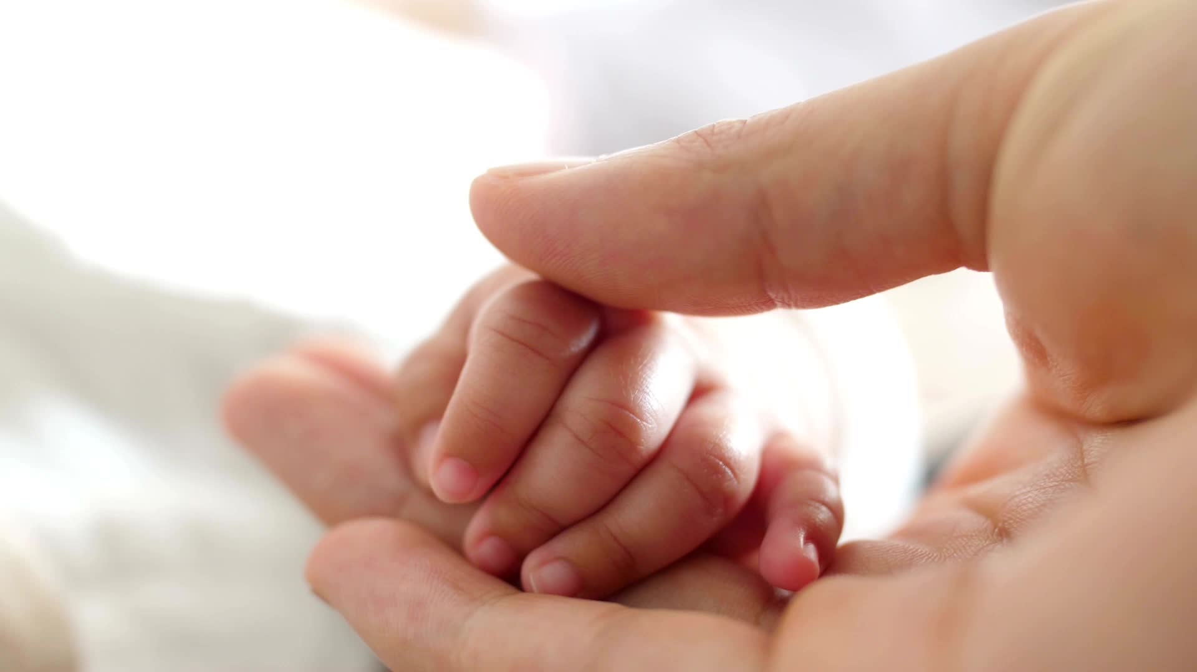
The Neurological Journey of Baby Human: Preconception/Pregnancy/Birth/Child
Laura Hanson, D.C., MS, QEEG-DL, D.I.C.C.P., NDT, BCN CAS
Patience Canty, D.C., C.D., C.N.P

Slide 2
Prenatal Development Dr. Canty Prenatal workup as a Doula and as a Chiropractor

Slide 3
Two Necessary Components of Your Birth Team
Doula – trained professional who provides physical, emotional, and informational support to individuals before, during, and after childbirth.
Do’s and Don’ts
Prenatal/perinatal Chiropractor –specializes in providing chiropractic care to pregnant individuals and new parents.
Perinatal physiological support
Perinatal health and functional wellbeing.

Slide 4
Prenatal Workup
Chiropractor
Doula
Birth Preferences
Physical Discomfort Related to Pregnancy
Postpartum Support
Nervous System Optimal Functioning
Previous Birth Experiences
Birth Preparation
Posture and Body Mechanics
Communication Preferences
Birth Environment
⮂
Stress Management
Concerns
&
Fears
Pelvic Alignment
Support System
Postpartum
Recovery
Expectations of the Doula
Exercise and Movement
Nutrition
&
Wellness
Education and Resources
Cultural & Religious Practices

Slide 5
Patient Cases
Started Prenatal Chiro Care @ 5 months pregnant
Adjusted into 4th Trimester
Undiagnosed Placenta Previa – Led to Emergency C-Section
Baby Boy Adjusted since Birth - Present

Slide 6
State of Health
NeuroImmune

Slide 7
The prenatal brain
Pregnancy – Immune suppressed state
Baby is considered “foreign” which maintains pregnancy
At the time of delivery mom’s T Cells change the suppression state and move towards a proinflammatory state
Baby it is time to come into world
Stress during pregnancy – mom can rob cortisol from the baby through the umbilical cord
Changes the entire environment and outcome
Hijacking the developing amygdala
Vaccines given to mom = proinflammation
28 - 36 weeks
Foreign injection > Inflammation > Mitochondria under stress

Slide 8
The prenatal brain
Pregnancy – Immune suppressed state
Baby is considered “foreign” which maintains pregnancy
At the time of delivery mom’s T Cells change the suppression state and move towards a proinflammatory state
Baby it is time to come into world
Stress during pregnancy – mom can rob cortisol from the baby through the umbilical cord
Changes the entire environment and outcome
Hijacking the developing amygdala
Vaccines given to mom = proinflammation
28 - 36 weeks
Foreign injection > Inflammation > Mitochondria under stress

Slide 9
Newest Vaccines
COVID
Not a vaccine
Gene therapy product
Mom is forced to respond to a synthetic mRNA > Spike Protein crosses the blood brain barrier
Outcomes
Increase risk for miscarriage
Seizures
Neuroimmune compromise to the mom and the developing baby

Slide 11
Prenatal / Postnatal Key Words
Apoptosis-As cells rapidly proliferate during development, some of them undergo apoptosis, which is necessary for many stages in development, including neural development.
Synaptogenesis is the final phase of axonal pathfinding. Its sequences of spatial and temporal development in the immature nervous system are precisely timed and consistent.
Pruning of synapses - As a baby’s brain develops, there is an explosion of synapses, the connections that allow neurons to send and receive signals. But during childhood and adolescence, the brain needs to start pruning those synapses, limiting their number so different brain areas can develop specific functions and are not overloaded with stimuli.

Slide 12
The Baby Brain
During the first trimester, the brain develops rapidly and makes up nearly half of the baby’s weight.

Slide 14
Second Trimester
During the second trimester, the baby’s brain begins to direct the compression of the chest muscles and movement of the diaphragm; the baby is still testing out movements, kicking and stretching.

Slide 15
Third Trimester
During the third trimester, there is rapid development of neurons in the brain and explosive growth.
The brain will triple in size during this time, growing from a little over 3 ounces to almost 11 ounces at birth; the cerebrum will begin to develop grooves and ridges and separate into the left brain and right brain.
The cerebellum is the fastest-growing part of the brain in the third trimester. This is the part responsible for motor control, the baby will begin to move more, wiggling fingers and toes, stretching, and kicking.

Slide 16
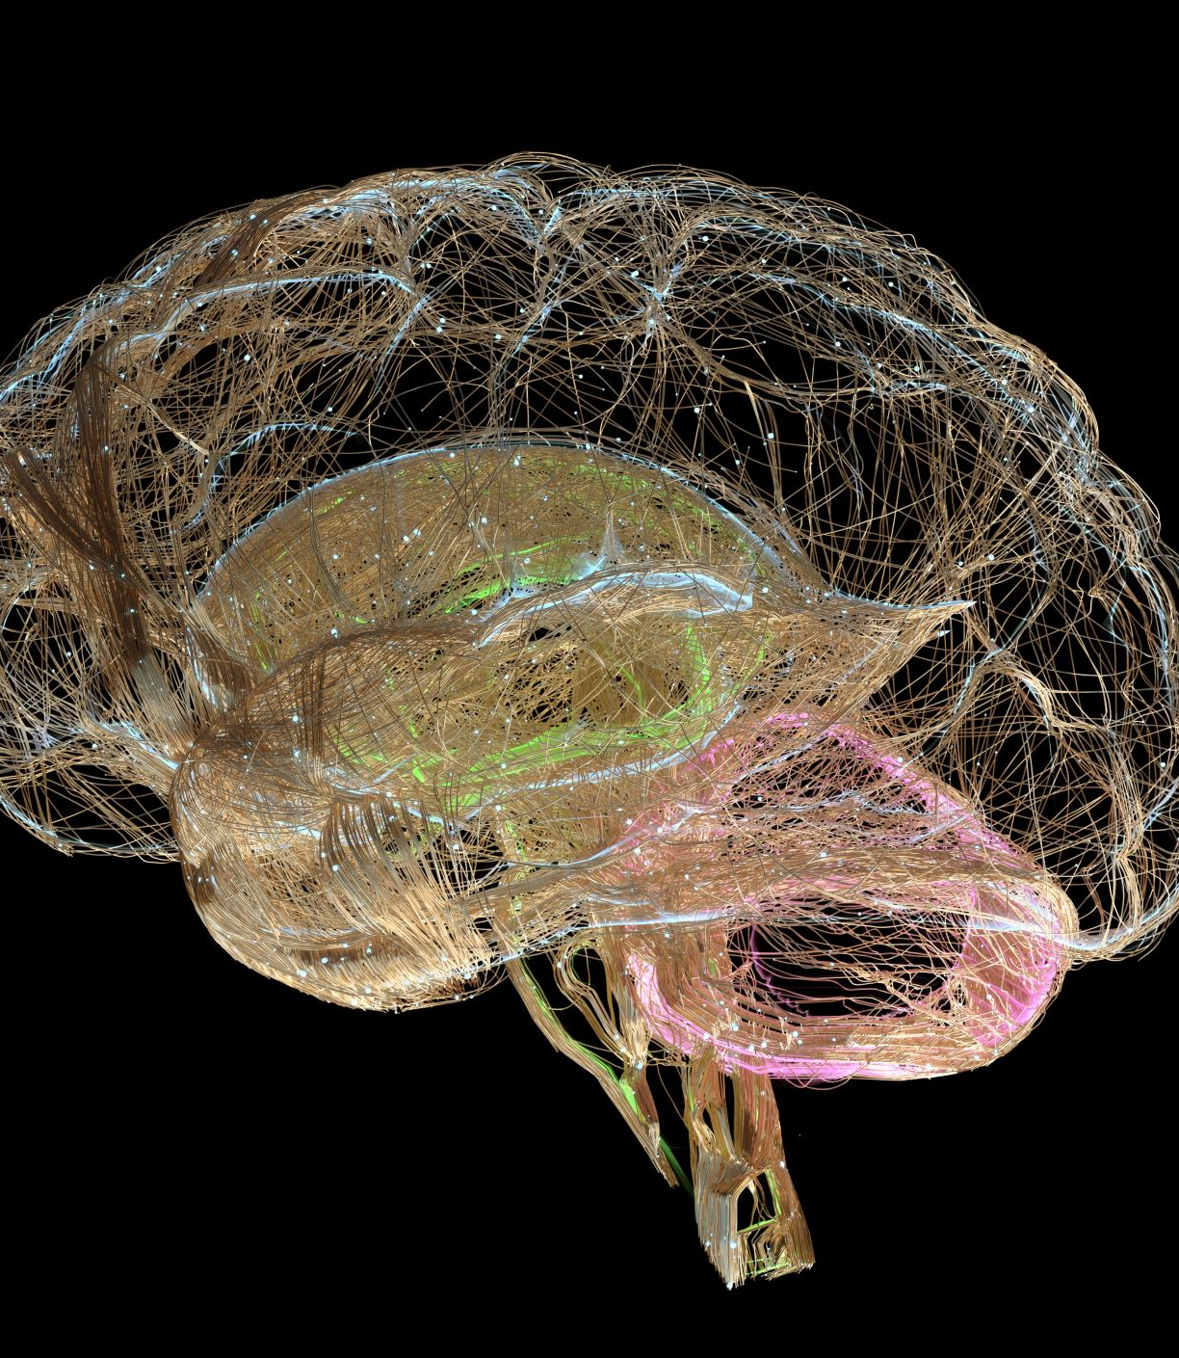
Brainwaves
The brainwaves that occur during sleep, controlled by the hypothalamus, begin occurring around week 28.
Your baby will begin experiencing sleep cycles, including REM sleep, the stage where dreaming occurs.

Slide 17
Special Senses Electrical Communicator
4 Weeks – is your pregnancy planned
What is your state of health at conception?
Withdrawal Reflexes
Primitive Reflexes
Eye development 4-10th weeks
Taste – 9 weeks
Touch receptors 8 weeks
Sound – 16-22 weeks
Breathing – 24 weeks
Smell – 32 weeks

Slide 18
Fixation of Gaze

Slide 19
6 Minutes of Phone Use

Slide 20
At birth: Toxic Soup and Chronic Condition
Umbilical study – 286 toxins in the umbilical blood
Glyphosate – in everything
N-(phosphonomethyl)glycine, looks like Lysine
Glycine and Lysine can swap out
Kill microbes in the gut
Associated with ADD, poor birth outcome. Poor muscle tone, developmental delay
Endocrine disruptor, Type II Diabetes, Obesity
Side Note: Lysine
Role in calcium absorption
Building muscle protein.
Aids in recovering from surgery or traumas
Helps your body produce hormones, enzymes, and antibodies.
Proved to depress the central nervous system while having antiseizure properties.

Slide 21
Glyphosate Causes Autism (in rodents)
https://www.ncbi.nlm.nih.gov/pmc/articles/PMC7260984/

Slide 22
Flouride
Fluoride is a human developmental neurotoxicant that reduces measures of intelligence in children, placing it into the same category as toxic metals (lead, methylmercury, arsenic) and polychlorinated biphenyls.
Mitochondrial toxicity creating the induction of apoptosis
Looks like Iodine – hardening bone, calcifying the pineal gland

Slide 23
Sub Conscious Mind
Responsible for recording events gathered through five sensory organs
The part of the mind not in the state of awareness
Contains memory banks
Emotional generators
Sensory input controller
Dedicated storage for habits

Slide 24
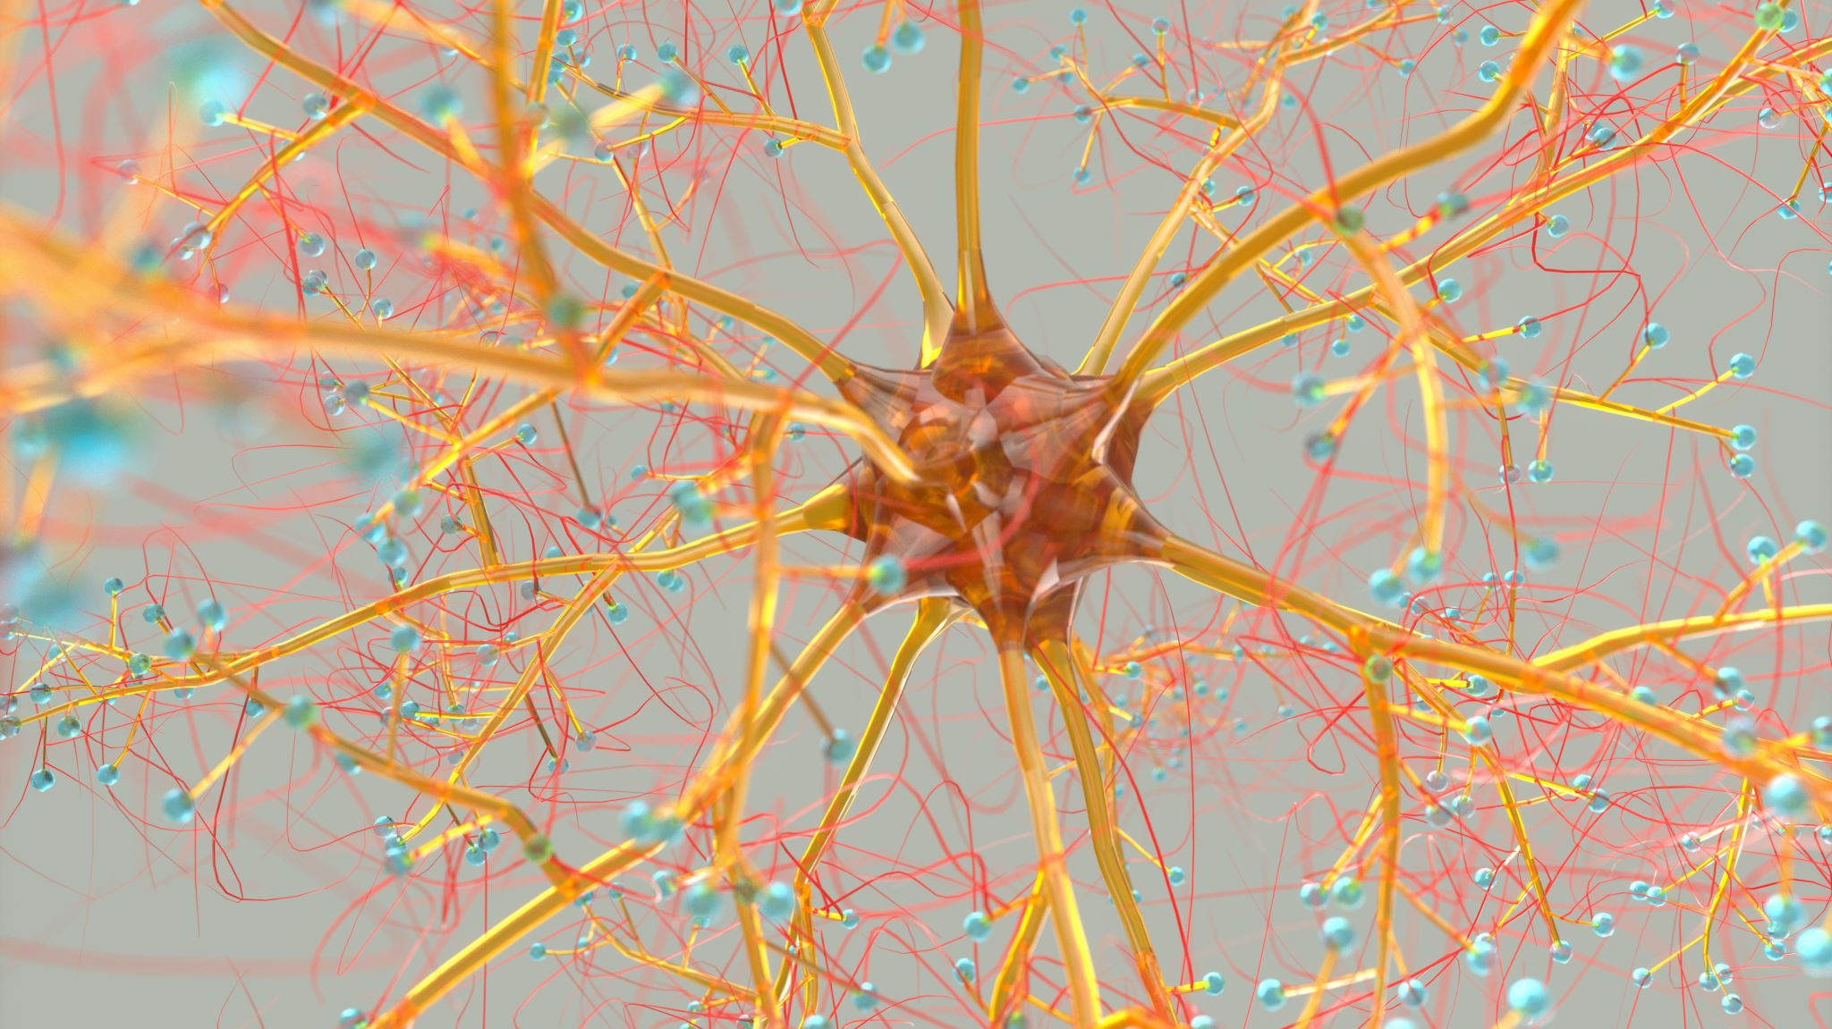
NeuroEmotional Technique

Slide 25
NET
Define
Identify questions
I am comfortable working with pregnant patients
I am comfortable working with children
Pulse Points (Handouts)
Arm and hands
Segmental
Breathing
Clearing

Slide 26
NeuroEmotional Technique

Slide 27
Pulse Points

Slide 28
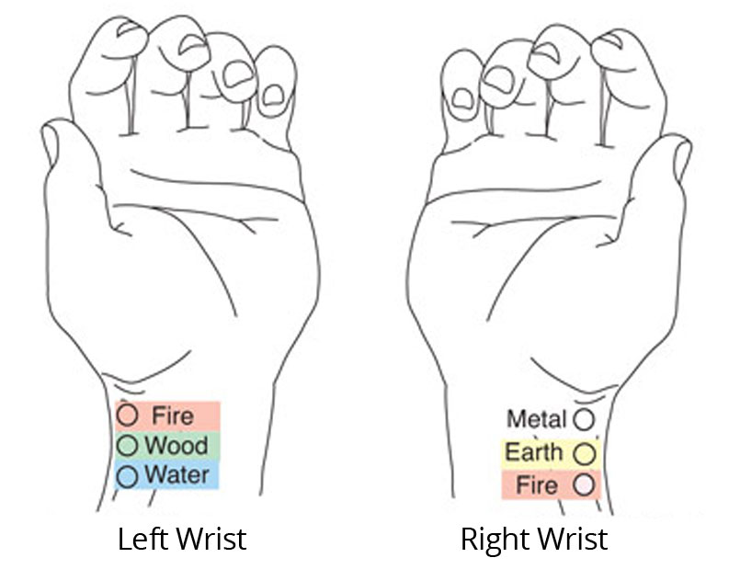
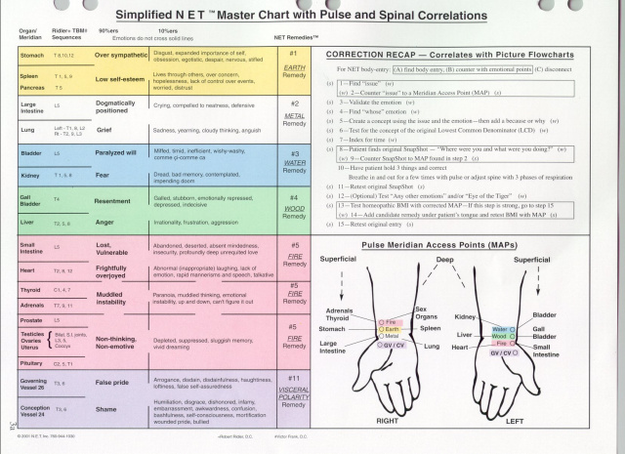
Emotions correlate with pulse points which correlate with vertebral segments
Mind Entries and Body Entries
Applications for Perinatal Populations and Pediatric Populations

Slide 29
Energy Workshop

Slide 30
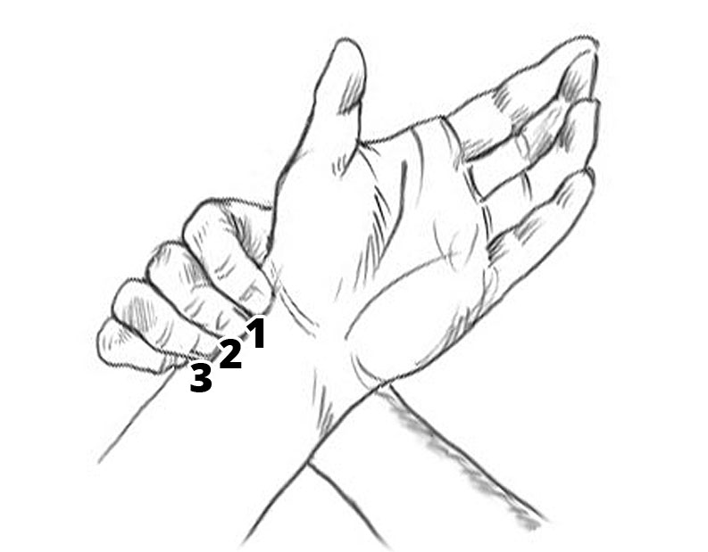
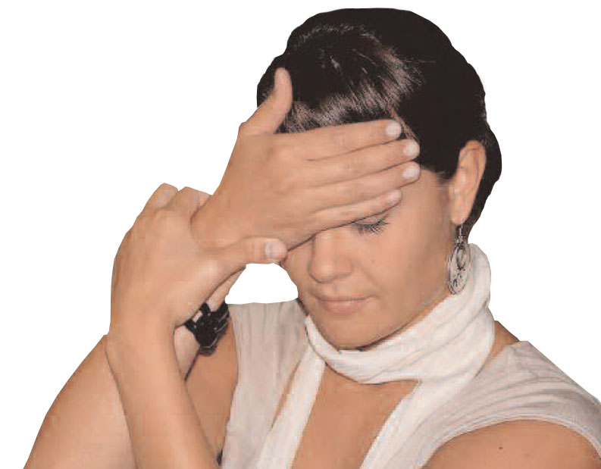
FAST
First-Aid Stress Tool

Slide 31
Postnatal Development
Developmental Blueprint
Developmental Milestones
The impact of the pandemic

Slide 32
Baby Human’s Blueprint
Pregnancy
Past Medical Hx
Familial Hx
Physiological Red Flags
Birth
Birth Process
Developmental milestones
Toddler
Gait
Pincer grasp
Communication
Social
Adaptation
School-age
Writing
Learning
Achieving

Slide 34
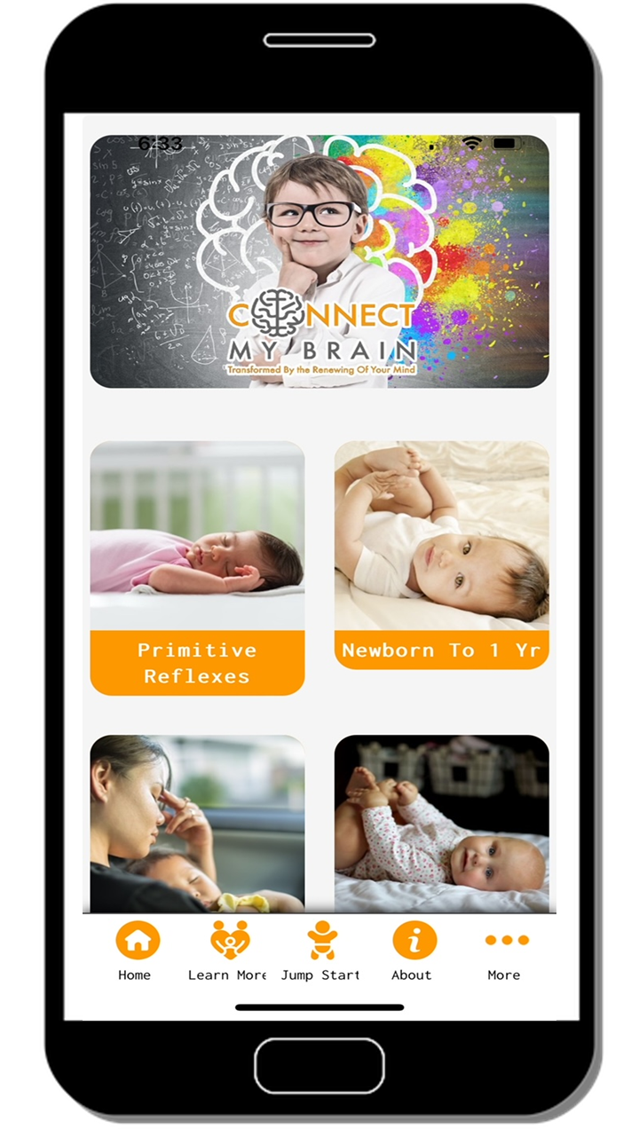
CMB App
Free
What children are supposed to do and when.
Videos
Podcast links
Support you parents and their children

Slide 35
CDC changed developmental acquisition normalizing developmental delay
Expected Language
CDC
7 weeks cooing sounds – “vowels”
9 months expresses joy
5 months – one syllable – “da”
8 months – two syllable – “da da”
12 months 2 to 3 words
2 months - Makes sounds other than crying
Reacts to loud sounds
4 months – sounds like “oooo” “aahh”
Turns head towards sound

Slide 36
Gross Motor
Expected movement
CDC – Crawling is not listed
4 weeks holds head momentarily
3 months supports head and shoulders supported by forearms
6 months sits unsupported in the upright position
9 months crawls
10 months cruises
12 months walks
2 months (8 weeks) – holds head up
4 months – pushes up on elbows
6 months – leans on hands to support themselves when sitting
9 sits unsupported
12 months pulls to stand
15 months – takes a few steps

Slide 37
Emotional clearing resulting after the pandemic
Aware
You have a technique now to help your patients with the emotional component
Chemical – shot or shedded upon (podcast Episode 121)

Slide 38
Management Plan
Physiological Restoration

Slide 39
Chiro-Doula Management Plan
Collaborate on & Discuss Birth Plan
Schedule out Remaining Adjustments for Pregnancy and Early Postpartum
Make Referrals to Necessary Professionals - - - i.e. Lactation support, Pelvic Floor PT, NET
Schedule Frequency for NET sessions
Schedule Periodic Reassessments (Chiropractically & WellnessNET)
Identify & Strategize on how to Remove or Manage additional Stressors that are not Structural or Emotional

Slide 40
Assessment Matrix
NeuroImmune Oxidative Stress Inflammation
GI Patient’s History Detoxification
Patient’s Chief Complaint
Musculoskeletal Emotional/Spiritual Endocrine

Slide 41
Newest Vaccines
COVID
Not a vaccine
Gene therapy product
Mom is forced to respond to a synthetic mRNA > Spike Protein crosses the blood brain barrier
Outcomes
Increase risk for miscarriage
Seizures
Neuroimmune compromise to the mom and the developing baby

Slide 42
Resources to share with your community
https://www.ewg.org/
https://www.scientificamerican.com/article/weed-whacking-herbicide-p/
https://www.scientificamerican.com/article/newborn-babies-chemicals-exposure-bpa/

Slide 43
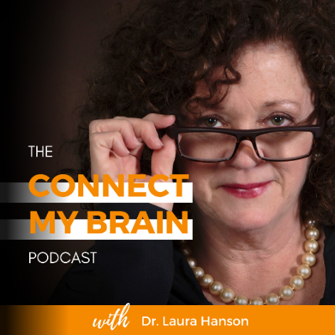
Reach out…
https://www.youtube.com/@dr.laurahanson4765
https://connectmybrain.com
https://www.connectmybrain.com/podcast/
https://connectmybrain.learnworlds.com
Connect My Brain App – Apple and Android https://apps.buzapps.net/pwapp/653b491e368f0/index.html
Email: drlaura@drlaurahanson.com

Slide 44
Reach out…
Instagram: @drpatti_thechirodoula or @flourish_wellness_center
NETMINDBODY.COM – Practitioner Finder zipcode 29707 or 30548
Email: drpatience@flourishwellnesschiro.com
Email: drpatiencethechirodoula@gmail.com

